Slide 1
6-CREATING AN INSTANCE

Slide 2
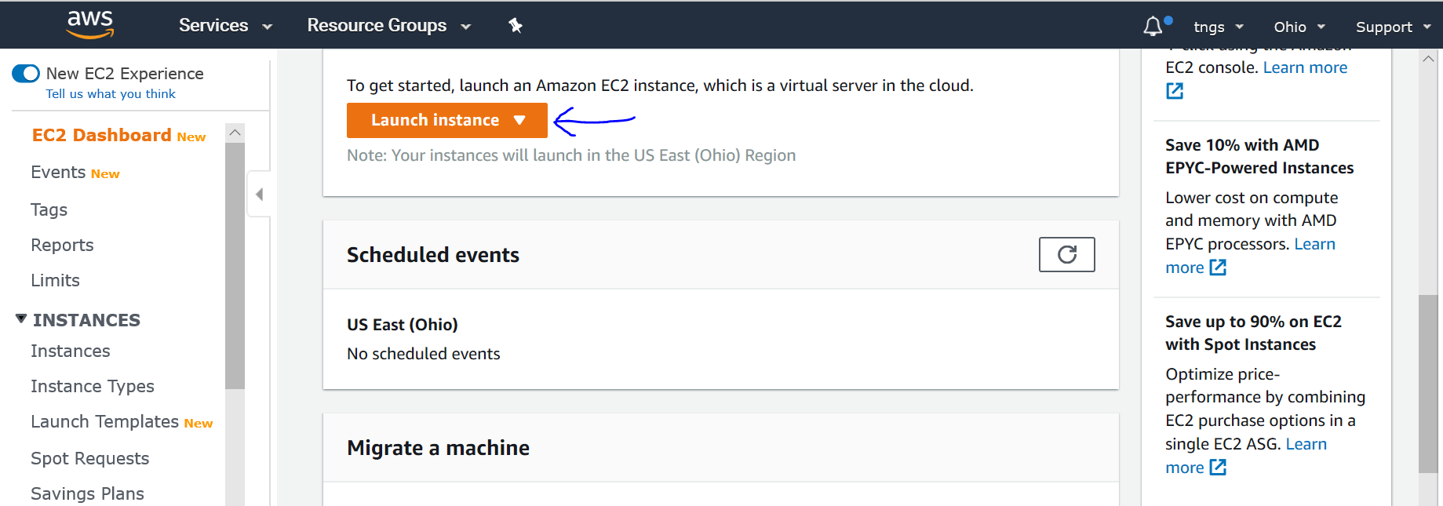
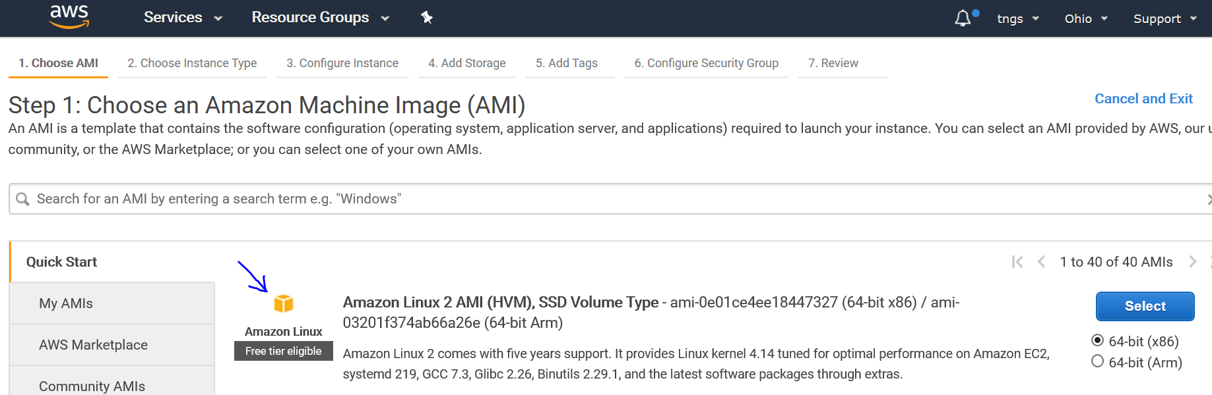
SPIN UP AN EC2 INSTANCE
Once you are on the EC2 dashboard, make sure once in which region you are in.
Next click on Launch Instance to start spinning our first server on AWS.
Next, select the OS flavor from the STEP 1, make sure that it has free tier eligible tag.

Slide 3
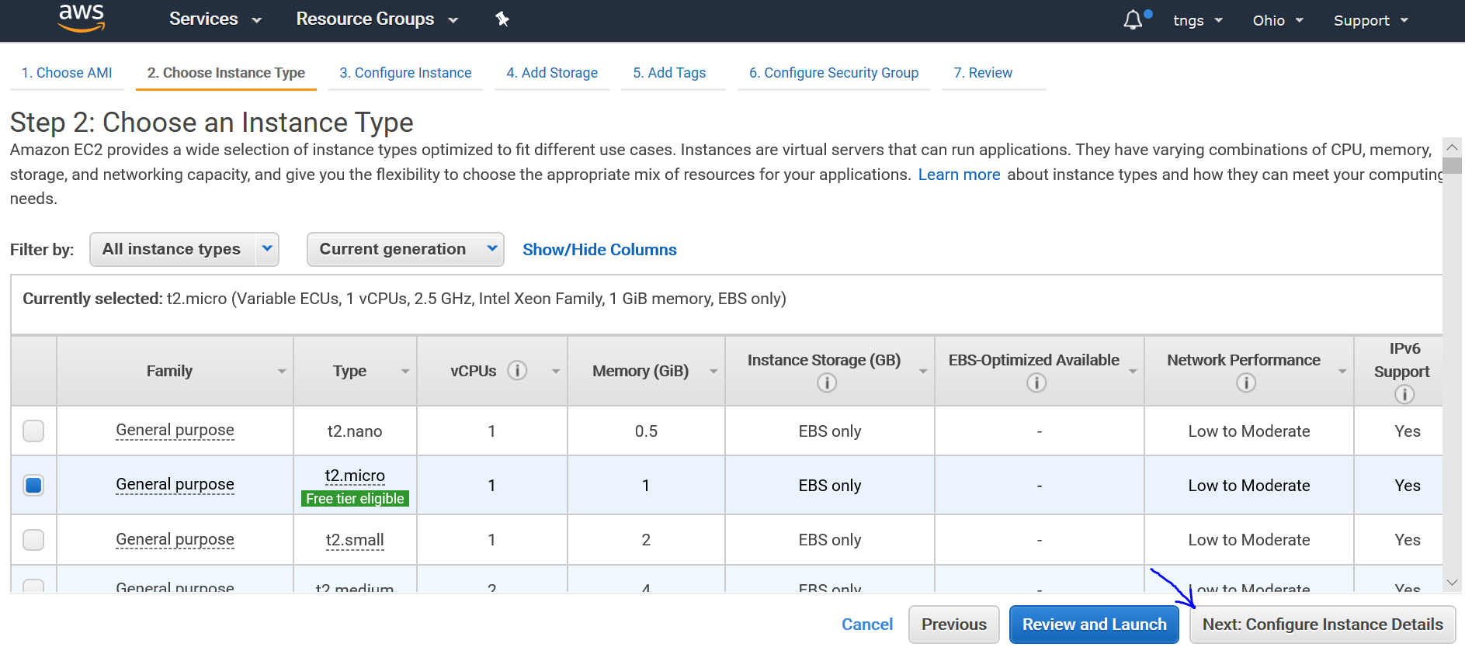
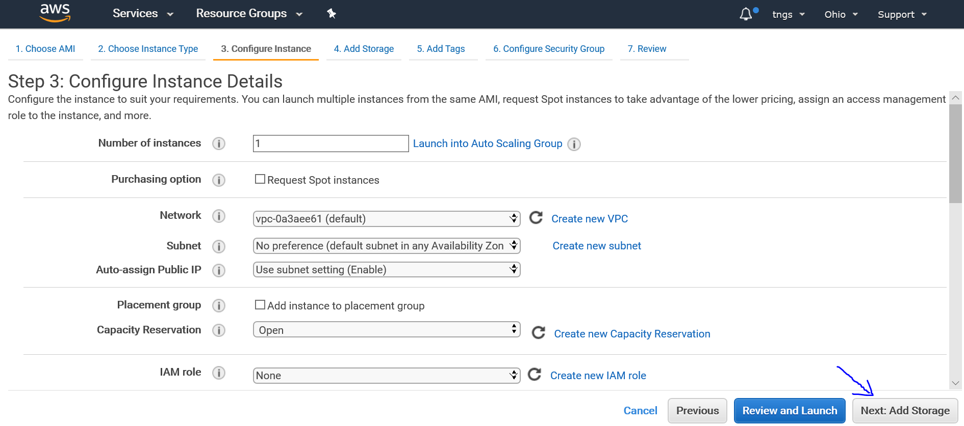
Next, click on Next: Configure Instance Details on the below right side of the page.
Next, click on Next: Add Storage on the below right side of the page.

Slide 4
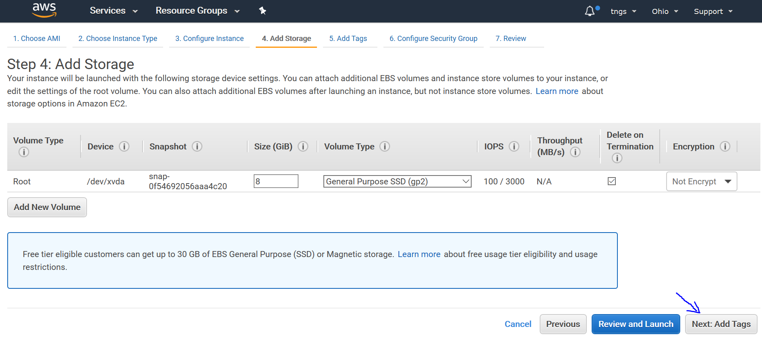
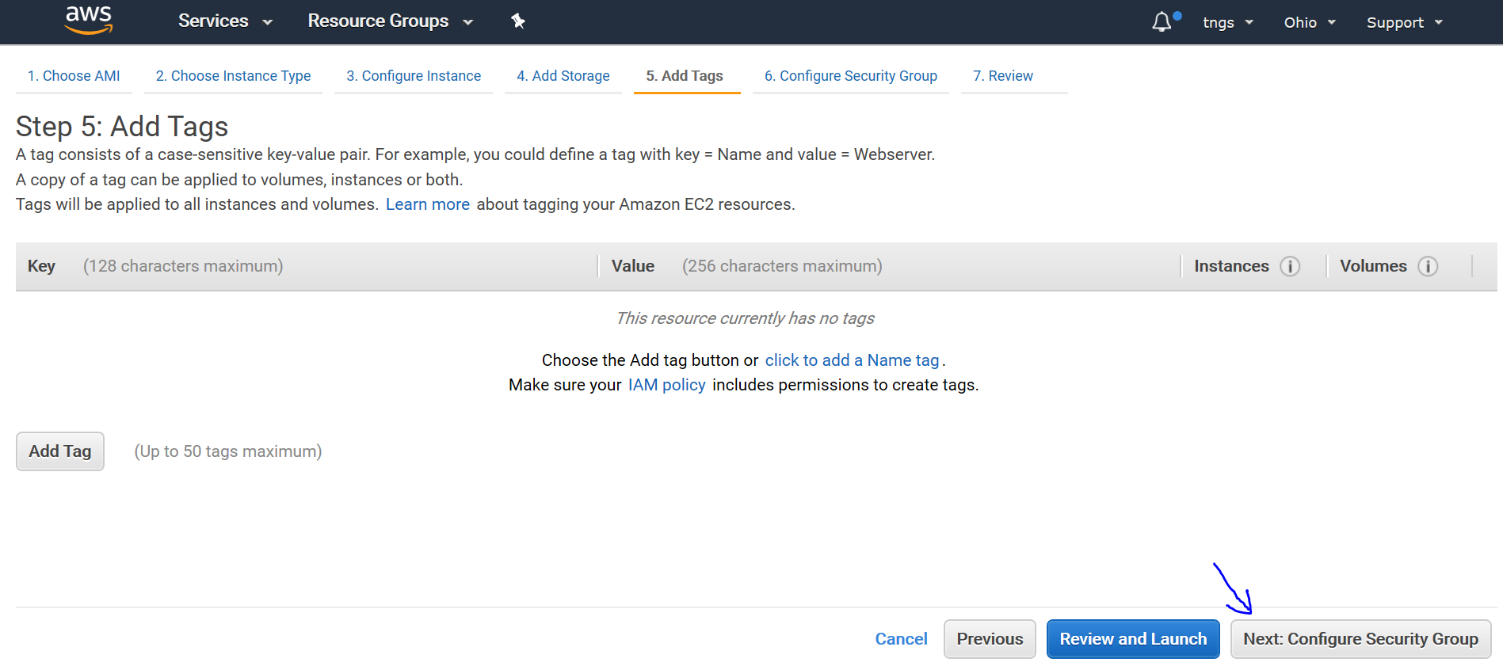
Next click on Next: Add tags from the below right side of the page.
Next, click on Next: Configure Security Group from the below right side of the page.

Slide 5
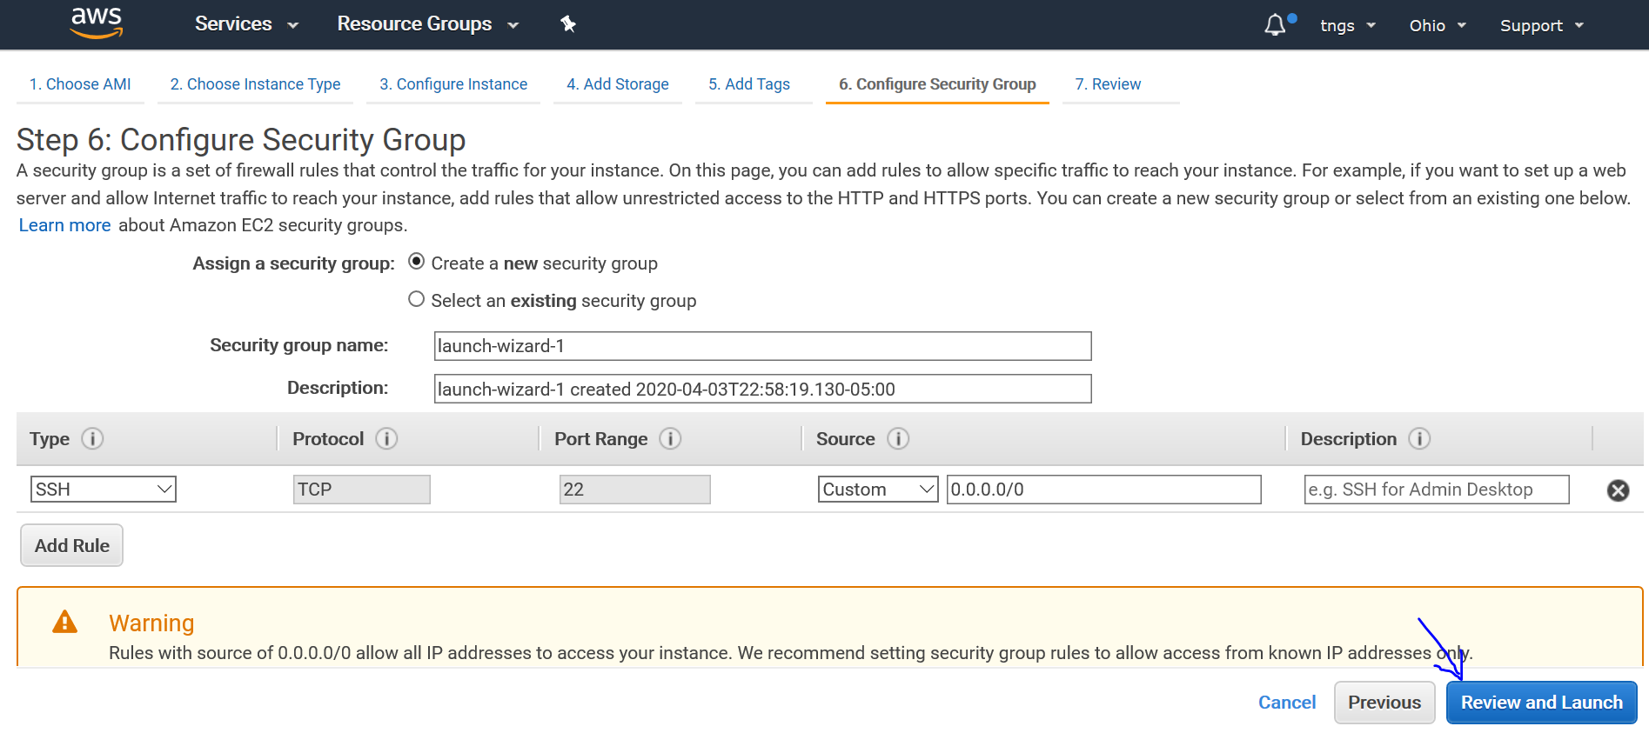
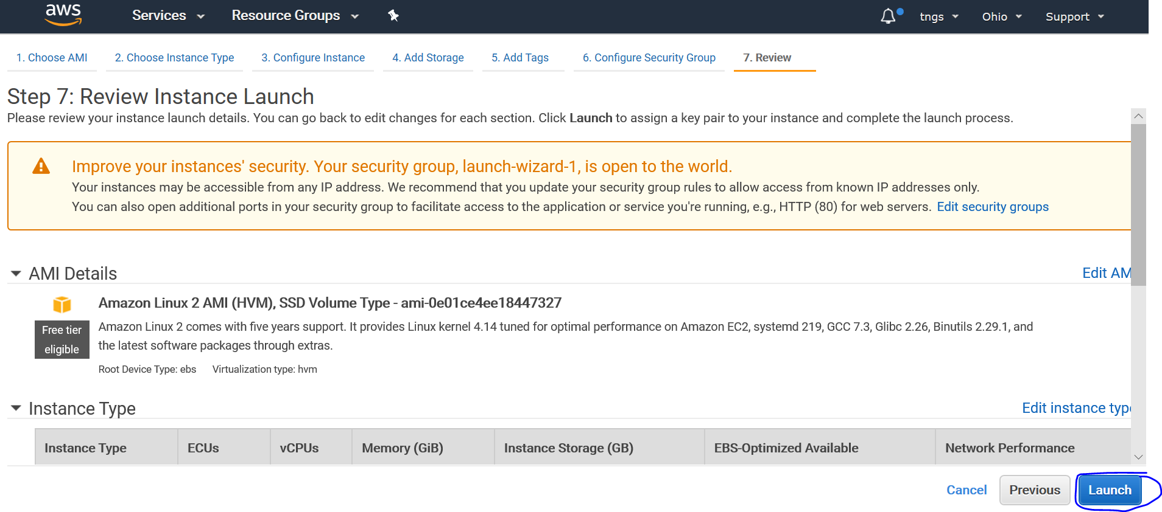
Next, click on Review and Launch from the below right side of the page.
Next, click on Launch form the below right side of the page

Slide 6
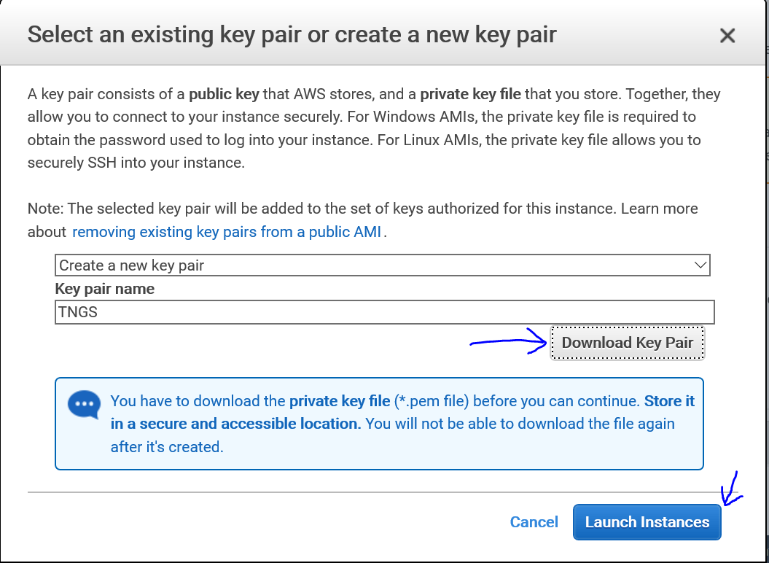
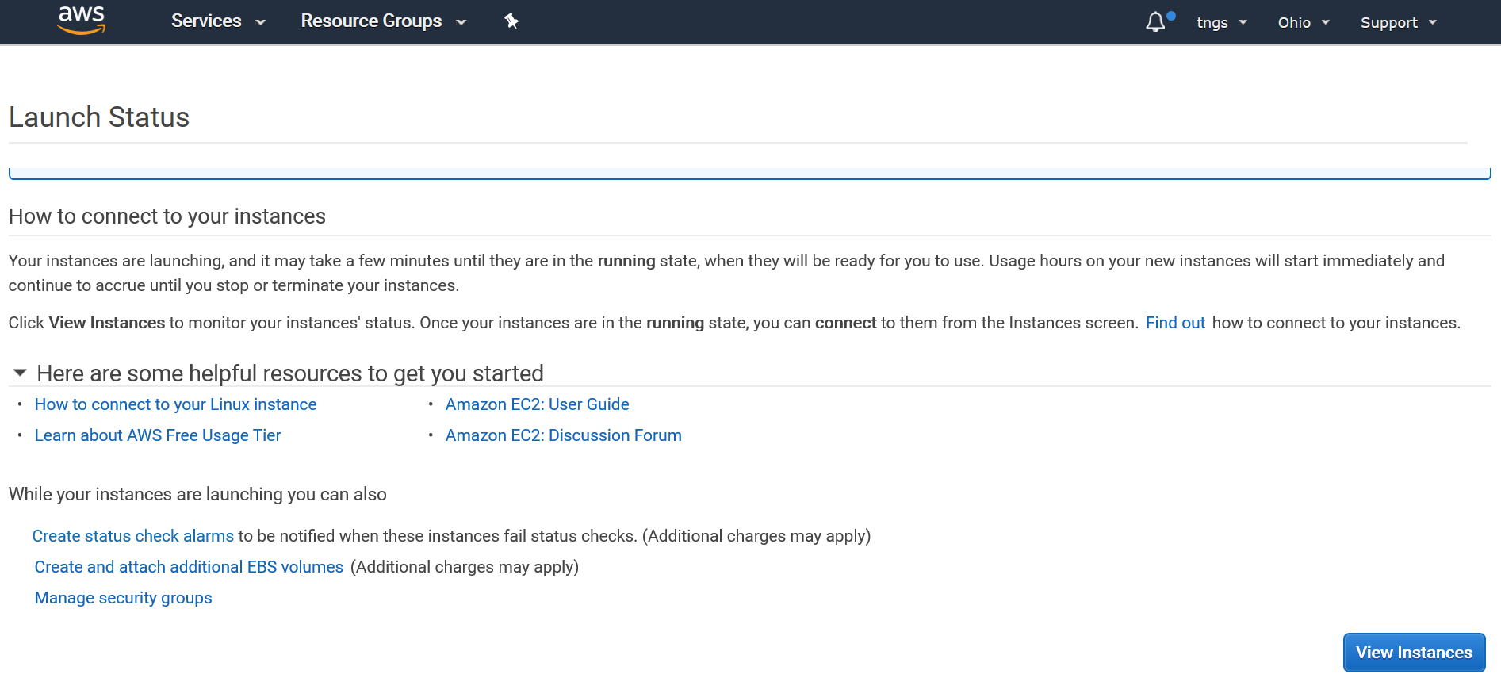
On the next page, if you have already created a keypair for your server, select an existing key Pair or select create a new keypair to create a new keypair then download your key pair. Click on Launch Instances
Your first instance is creating. Click on the View Instance button from the below right-side page.

